Slide 1
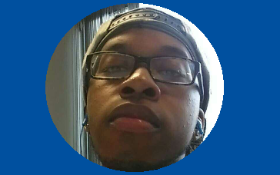
George Williams is currently a student at Hunter College planning to major in media, and a passionate gamer. He graduated from KIPP NYC College Prep in 2014 with the Advanced Regents Prep Diploma. He is currently employed at KIPP as a Teacher’s Assistant for a Science faculty of 13 teachers. He’s also been a soccer coach in Brooklyn for children aged 13 through 17. Surrounded by other teenagers that play games, he leverages his opportunities to discuss trends and gather insights in customer segments that have led to the growth of the gaming industry. His goal is to make a website that connects gamers to game developers.

Slide 2

George Williams, Founder
Notes:
Personal Intro and transition to the project name
Time: 40-60 seconds

Slide 3
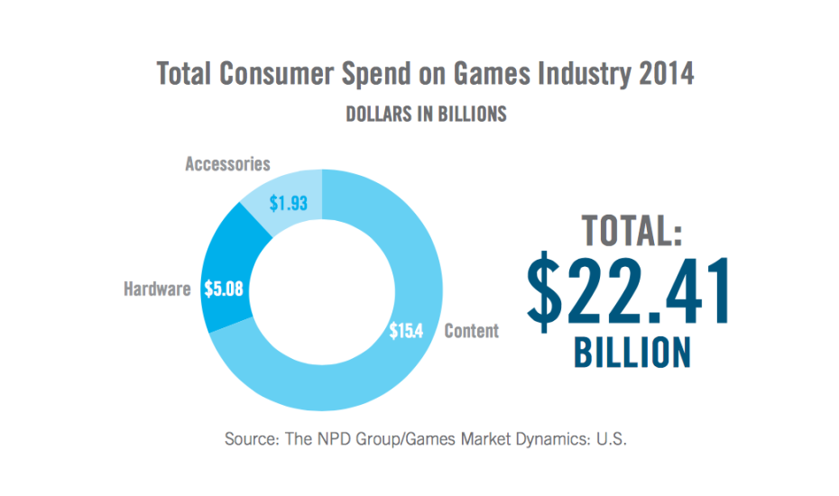
Market Opportunity

Slide 4
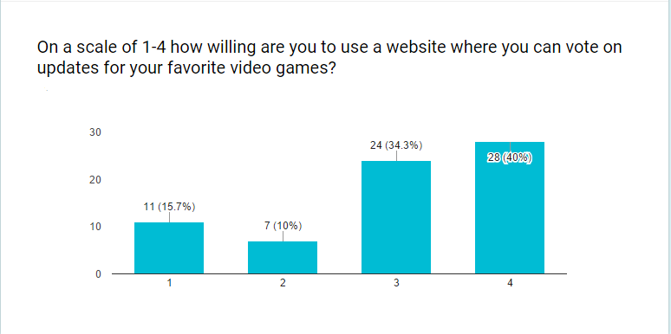
Customer Insights

Slide 5
Value Proposition
Gamers space to voice their ideas
Developers gain a source to receive customer input better games for players, as well as push updates out faster
Developers gain a reliable space to advertise updates to a large base of gamers

Slide 6



How It Works
Sign Up/ Sign In
Upvote/Downvote
Post Your Own Opinions
Connect With Other Gamers Via GameChats

Slide 7
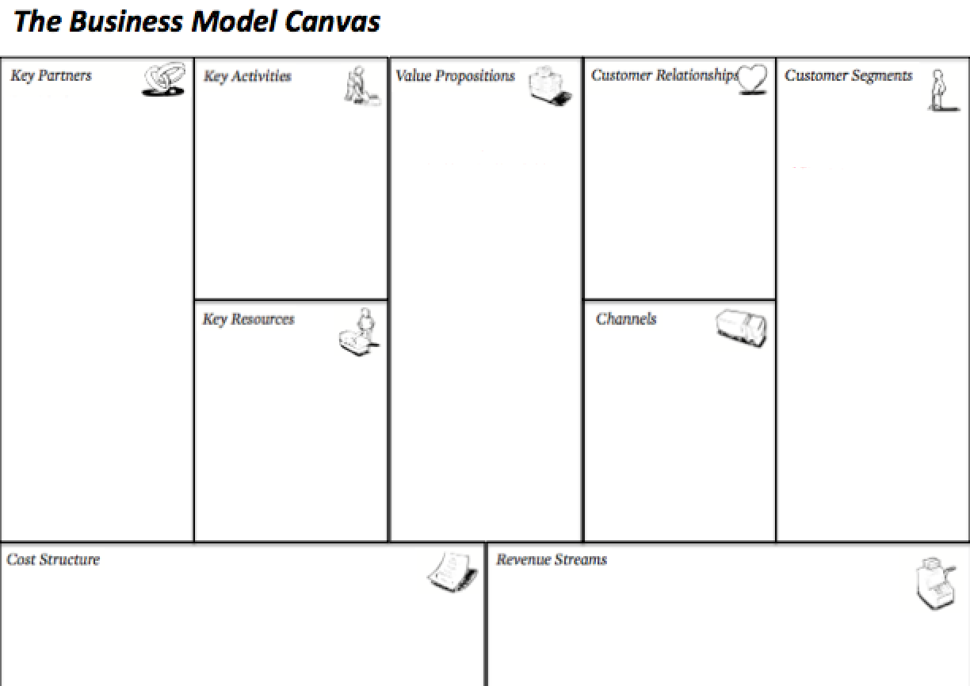
Website development
Application development
Focus groups w/ game developers and gamers
GameStop
Twitch
Reddit
Game Developers
Exclusive access to new content
Low cost membership
Highly-sought feature access
Opinion Voicing- Gamers can offer update ideas
Ad Space for Devs- Devs get a concentrated base to advertise to
Account Linking- Users connect their game accounts
Walkthrough - Many users sought a walkthrough feature in my competitors
Gamers between the ages of 11 and 40
Developers of major video game companies
Survey goers expressed their age range not being represented, expanding age range to 60
Users
Advertisement
Website
Potential App
Domain Pricing
Website Management and Maintenance
Website Development
Sale of aggregate data to video game developers
Ad space for developers to advertise games
Subscription service for additional features
Notes:
Present what your initial thoughts were on your business model canvas; Contrast with what you learned from class, interviews and surveys and the changes you made to the canvas
Time: 80-120 seconds

Slide 8
Revenue Model
Sale of aggregate data to video game developers
Ad space for developers to advertise games
Subscription service for additional features

Slide 9
Go-To-Market Strategy
Deadline | Milestone | Strategy
Dec. 2017 | Website will be fully developed, and ready to go live | Hire developers expert in forum building
Aug. 2018 | 1,000 daily users | Make connections with Twitch and GameStop to expand user base
Notes:
Describe how you will get your product out to the customer segments
Time: 40-60 sec

Slide 10

George Williams, Founder
Notes:
Close with an ask (for mentorship, money, site visit, etc.)- then drive home the mission statement or slogan. Thank everyone, and transition to a demo of the app/website you created so that they can ask questions for Q/A later

